Slide 1
Other Settings and Variants of Reinforcement Learning
CS229
Tengyu Ma
Notes:
Pictures of Rong and Jason `

Slide 2
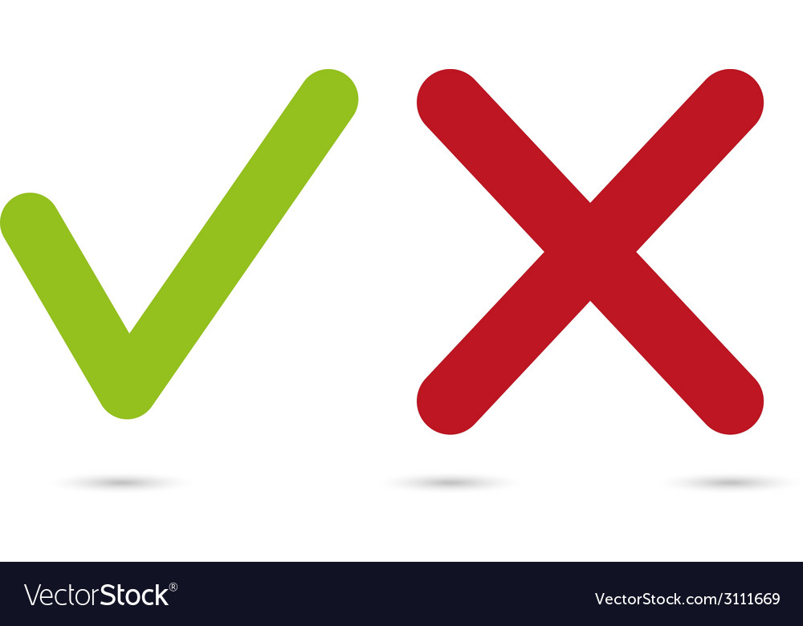
RL Settings Covered in This Class
Learn from trials and errors
Start “from scratch” (no training data)
Interact with the environments
Go, chess, and Atari: trials in computers because dynamics/transition probabilities is known
Robotics, autonomous cars: trials in real-world
samples are more precious than runtime
sample efficiency: model-based vs model-free RL
Observe the reward
Observe the states
Discrete (tabular) or continuous state space

Slide 3
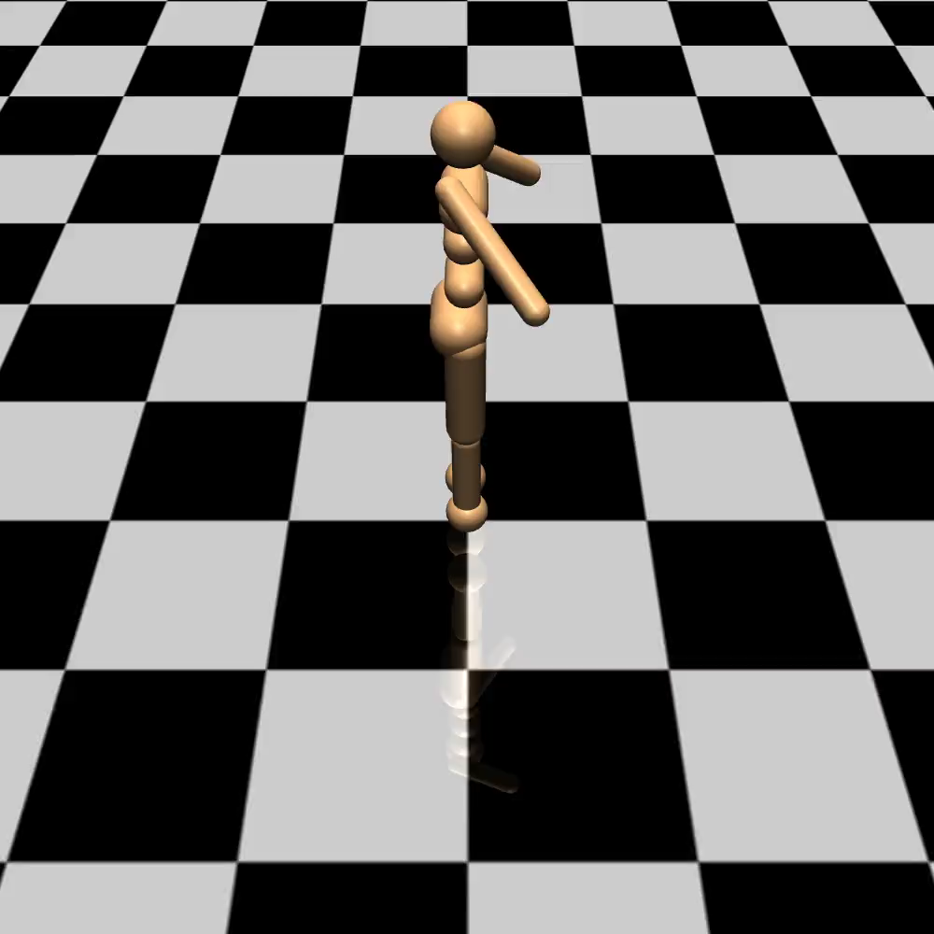
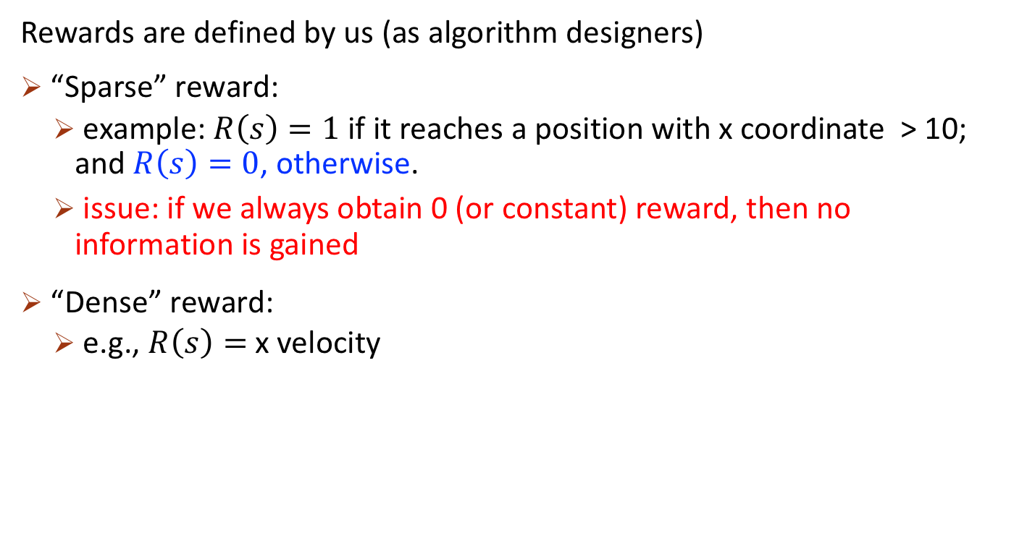
Where do the rewards come from?
Rewards are defined by us (as algorithm designers)
“Sparse” reward:
example: $R\left(s\right)=1$ if it reaches a position with x coordinate > 10; and $R\left(s\right)=0$, otherwise.
issue: if we always obtain 0 (or constant) reward, then no information is gained
“Dense” reward:
e.g., $R\left(s\right)=$ x velocity

Slide 4

Rewards Shaping (Designing Dense Rewards)
Reward = distance between current rotation angle and the desired angle
Note that the rotation angle is not part of the states, and need to be predicted by a neural net
Video credit: openAI blog
https://openai.com/blog/learning-dexterity/
Learning Dexterous In-Hand Manipulation

Slide 5
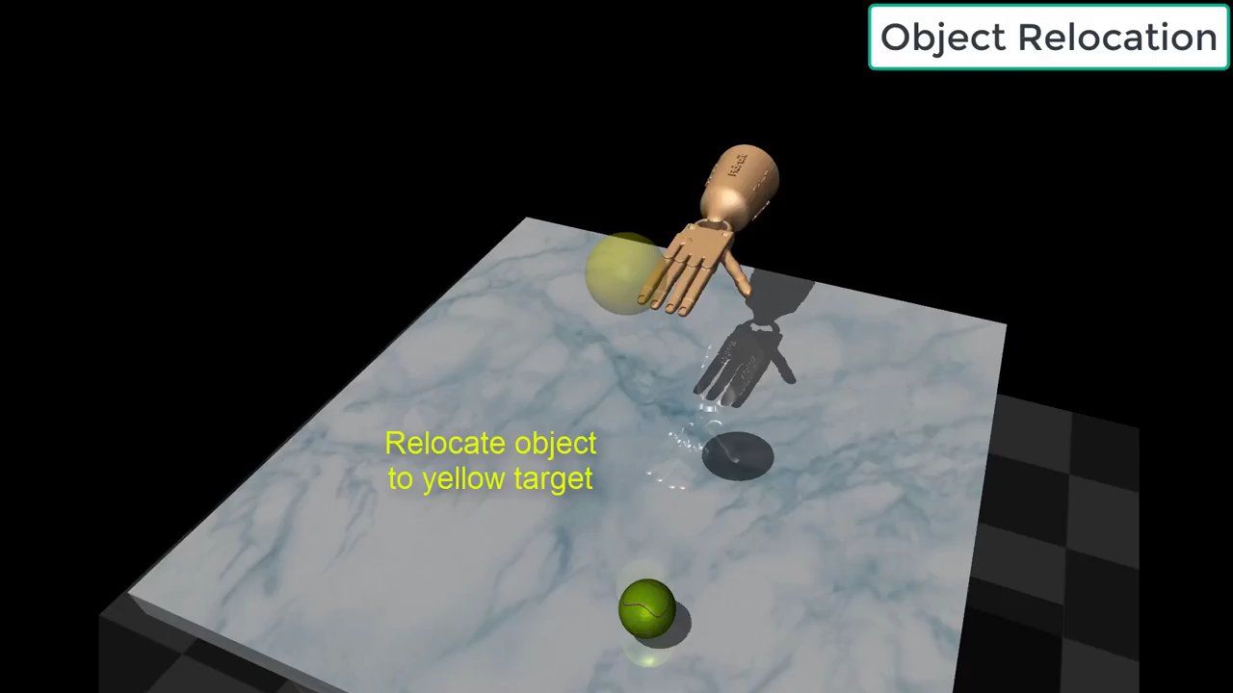
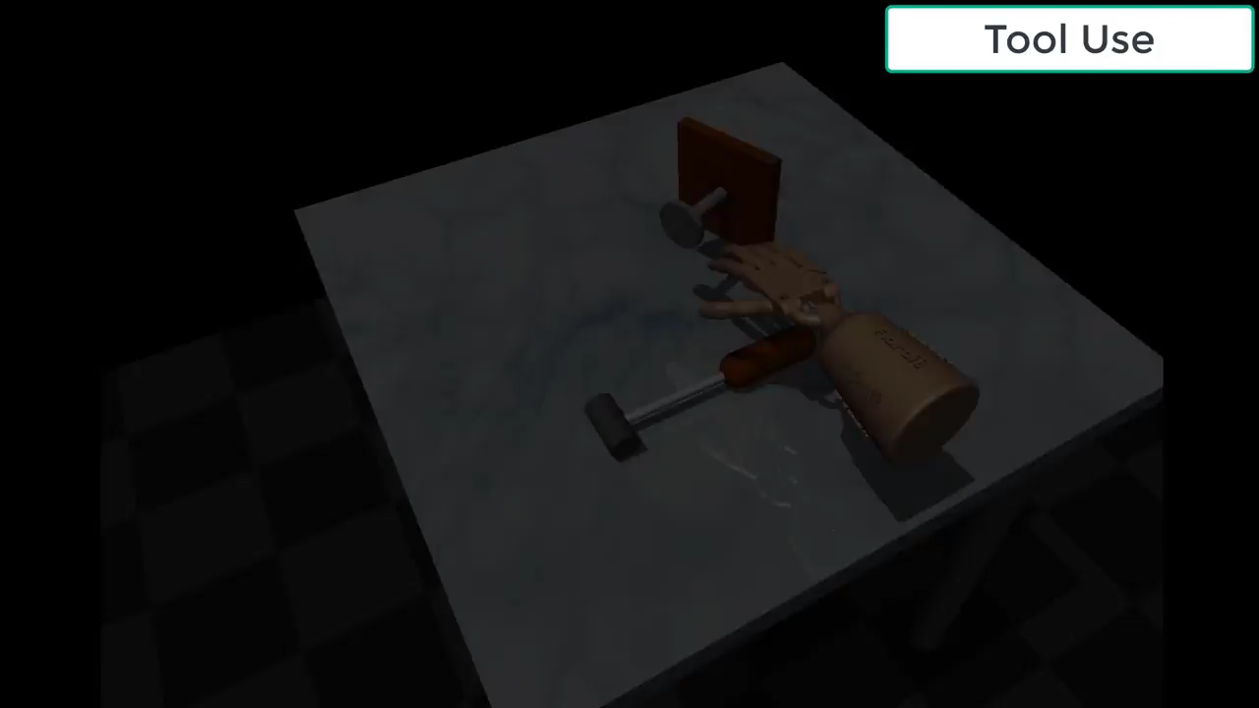
Reward Shaping may be Difficult for Complex Tasks
Reward = ?
negative distance between hand to the goal location
negative distance between the ball and the goal location
no informative reward before the hand accidentally touches the ball
A complicated reward may work
- dist(hand, ball) if the hand doesn’t touch the ball; - dist(ball, goal) o.w.
Video credit: Learning Complex Dexterous Manipulation with Deep Reinforcement Learning and Demonstrations, Rajeswaran et al.’17. https://www.youtube.com/watch?time_continue=53&v=jJtBll8l_OM

Slide 6
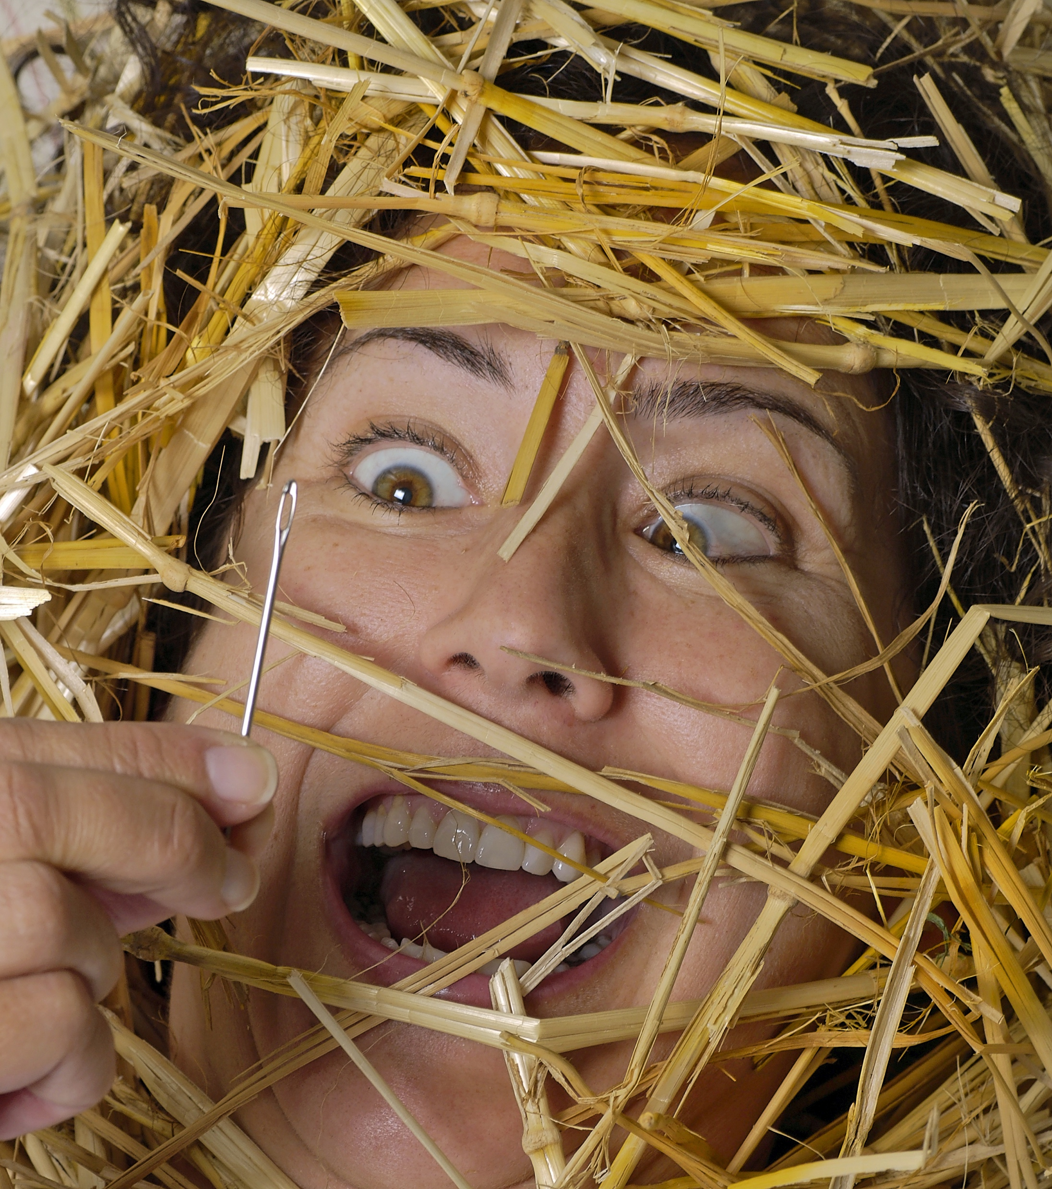
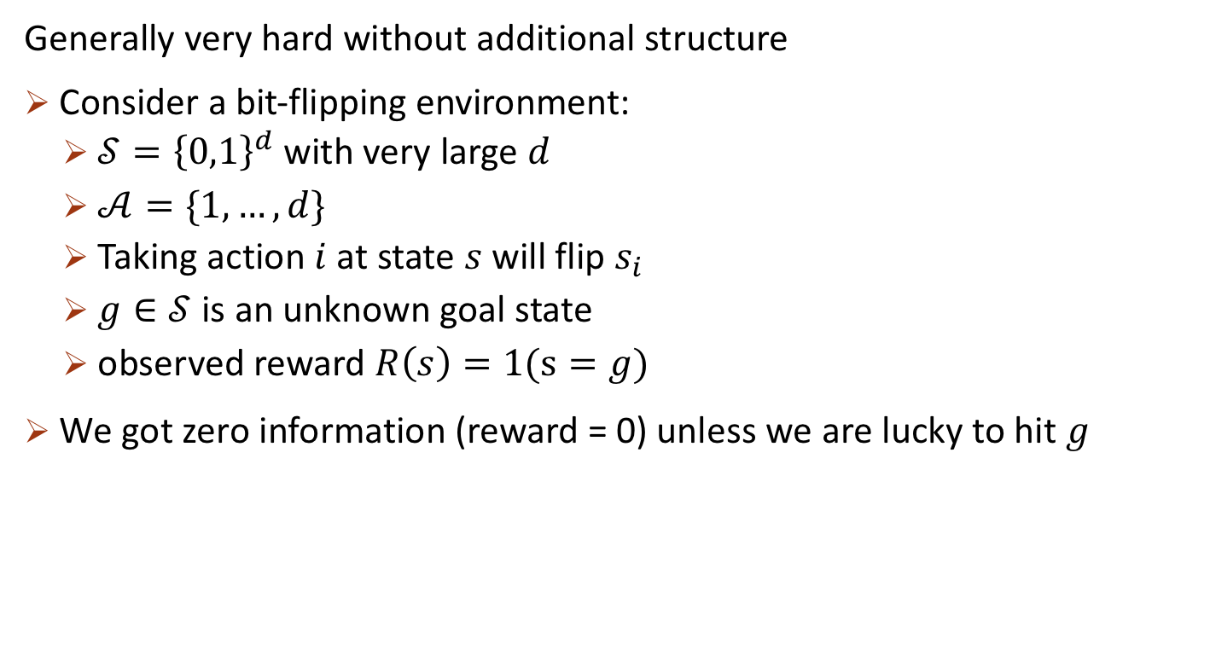
RL with Sparse Rewards
Generally very hard without additional structure
Consider a bit-flipping environment:
$𝒮={\left\{0,1\right\}}^{d}$ with very large $d$
$𝒜=\{1,…, d\}$
Taking action $i$ at state $s$ will flip $s_{i}$
$g∈𝒮$ is an unknown goal state
observed reward $R\left(s\right)=1(s=g)$
We got zero information (reward = 0) unless we are lucky to hit $g$
Hindsight Experience Replay [Andrychowicz et al.’17]

Slide 7
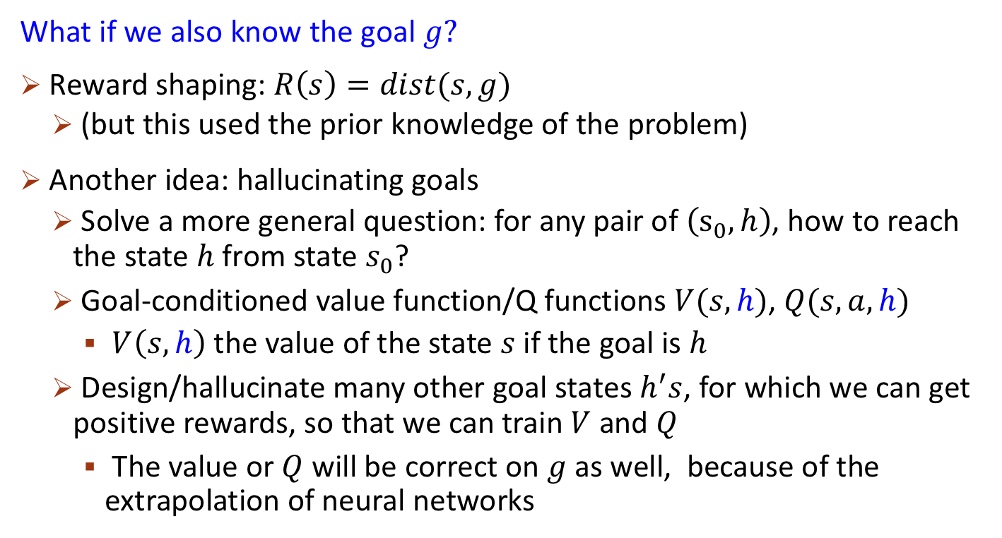
Learning with Sparse Rewards
What if we also know the goal $g?$
Reward shaping: $R\left(s\right)=dist(s,g)$
(but this used the prior knowledge of the problem)
Another idea: hallucinating goals
Solve a more general question: for any pair of $\left(s_{0},h\right)$, how to reach the state $h$ from state $s_{0}$?
Goal-conditioned value function/Q functions $V(s,h)$, $Q(s,a,h)$
$V\left(s,h\right)$ the value of the state $s$ if the goal is $h$
Design/hallucinate many other goal states $h^{′}s$, for which we can get positive rewards, so that we can train $V$ and $Q$
The value or $Q$ will be correct on $g$ as well, because of the extrapolation of neural networks
Hindsight Experience Replay [Andrychowicz et al.’17]

Slide 8
RL Settings Covered in This Class
Learn from trials and errors
Start “from scratch” (no training data)
Interact with the environments
Observe the reward
Observe the states
Discrete (tabular) or continuous state space

Slide 9
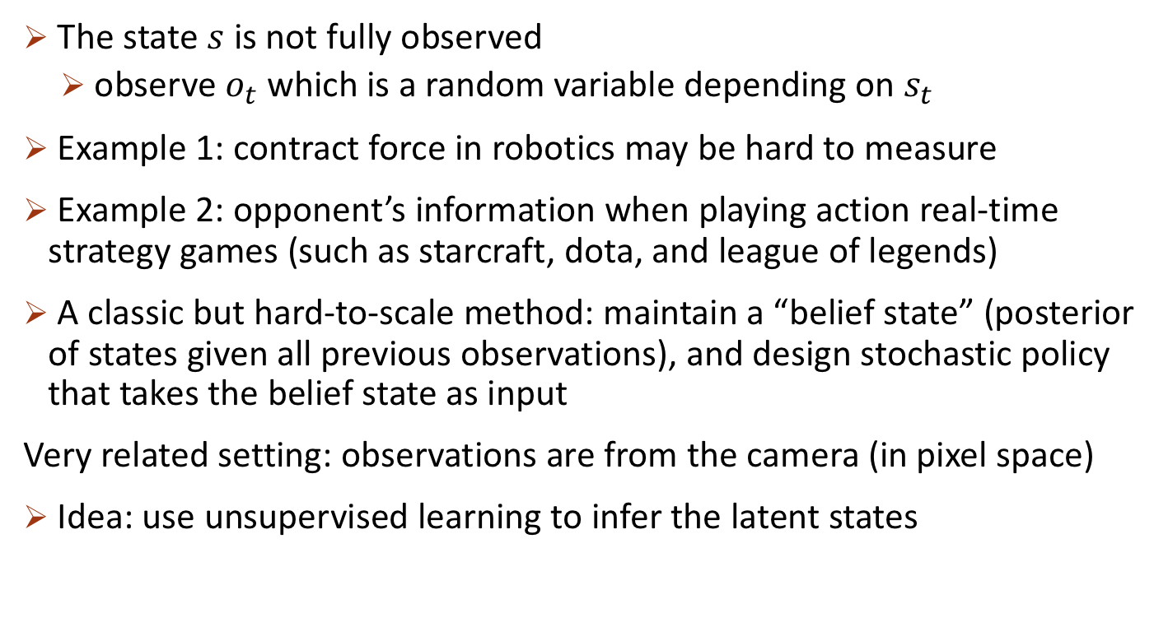
Partially Observable Markov Decision Process (POMDP)
The state $s$ is not fully observed
observe $o_{t}$ which is a random variable depending on $s_{t}$
Example 1: contract force in robotics may be hard to measure
Example 2: opponent’s information when playing action real-time strategy games (such as starcraft, dota, and league of legends)
A classic but hard-to-scale method: maintain a “belief state” (posterior of states given all previous observations), and design stochastic policy that takes the belief state as input
Very related setting: observations are from the camera (in pixel space)
Idea: use unsupervised learning to infer the latent states

Slide 10
RL Settings Covered in This Class
Learn from trials and errors
Start “from scratch” (no training data)
Interact with the environments
Observe the reward
Observe the states
Discrete (tabular) or continuous state space

Slide 11
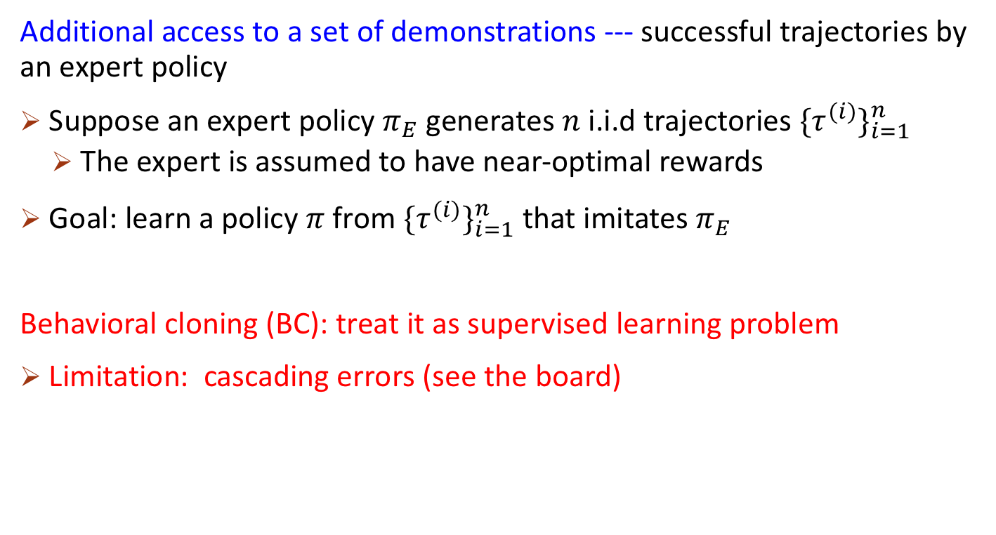
Imitation Learning (Learning from Demonstrations)
Additional access to a set of demonstrations --- successful trajectories by an expert policy
Suppose an expert policy $π_{E}$ generates $n$ i.i.d trajectories $\{τ^{(i)}\}_{i=1}^{n}$
The expert is assumed to have near-optimal rewards
Goal: learn a policy $π$ from $\{τ^{(i)}\}_{i=1}^{n}$that imitates $π_{E}$
Behavioral cloning (BC): treat it as supervised learning problem
Limitation: cascading errors (see the board)

Slide 12
RL Settings Covered in This Class
Learn from trials and errors
Start “from scratch” (no training data)
Interact with the environments
Observe the reward
Observe the states
Discrete (tabular) or continuous state space

Slide 13
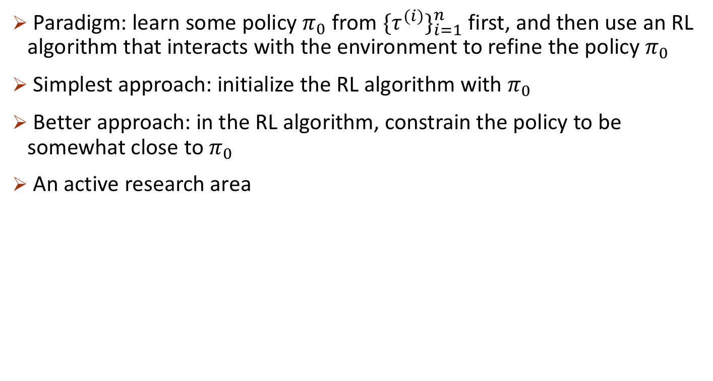
Imitation Learning with Environment Interactions
Paradigm: learn some policy $π_{0}$ from $\{τ^{(i)}\}_{i=1}^{n}$first, and then use an RL algorithm that interacts with the environment to refine the policy $π_{0}$
Simplest approach: initialize the RL algorithm with $π_{0}$
Better approach: in the RL algorithm, constrain the policy to be somewhat close to $π_{0}$
An active research area
Overcoming Exploration in Reinforcement Learning with Demonstrations [Nair et al.’18]
Leveraging Demonstrations for Deep Reinforcement Learning on Robotics Problems with Sparse Rewards [Vecerik et al.’18]
Learning complex dexterous manipulation with deep reinforcement learning and demonstrations. [Rajeswaran et al’18]
Deep q-learning from demonstrations. [Hester et al.’ 18]

Slide 14
RL Settings Covered in This Class
Learn from trials and errors
Start “from scratch” (no training data)
Interact with the environments
Observe the reward
Observe the states
Discrete (tabular) or continuous state space

Slide 15
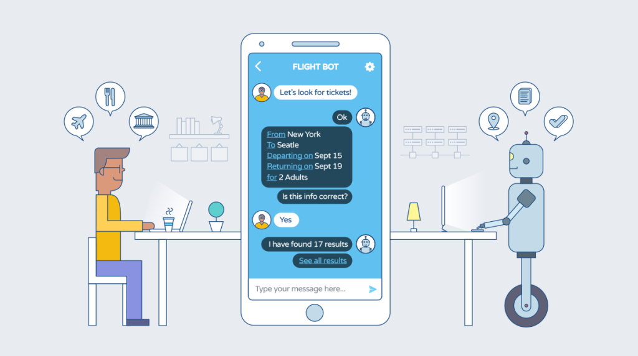
Applications of RL in NLP
Training/controlling a chat bot
Actions: sentences that the bot say
States: all past messages
Goal: the bot completes some tasks, e.g., books a ticket for the human
Challenges
action space and state space are huge discrete space (all possible sentences)
large-scale interactions with humans are hard to obtain or simulate

Slide 16
RL Settings Covered in This Class
Learn from trials and errors
Start “from scratch” (no training data)
Interact with the environments
Observe the reward
Observe the states
Discrete (tabular) or continuous state space
Bottom line: choose the most suitable setting and algorithms for you applications

